Slide 1

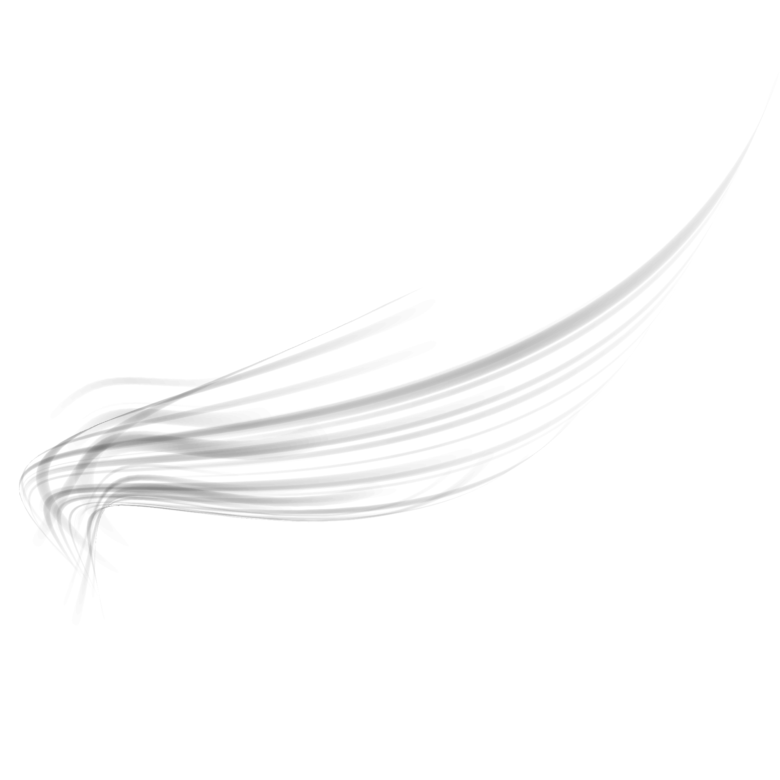
Unlock
typography

Slide 2
01
Types of Fonts

Slide 3
Types fonts
Serif
Sans-serif
Script
Display or Decorative
Slab-serif

Slide 4
How to identify fonts?

Slide 5
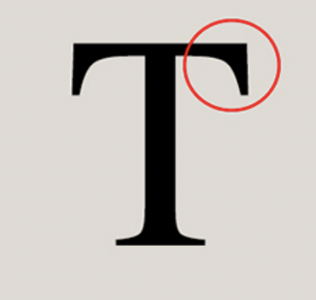
Serif
Serif fonts are typefaces that have serifs,
which are extra strokes on the ends of their letterforms.

Slide 6

Sanserif
A sans serif font is basically any font that doesn't have little dashes at the end of each letter.

Slide 7
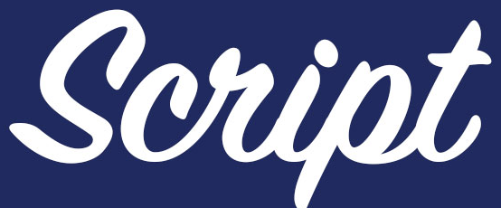
Script
A script font is a classification of fonts designed to resemble traditional cursive handwriting.

Slide 8

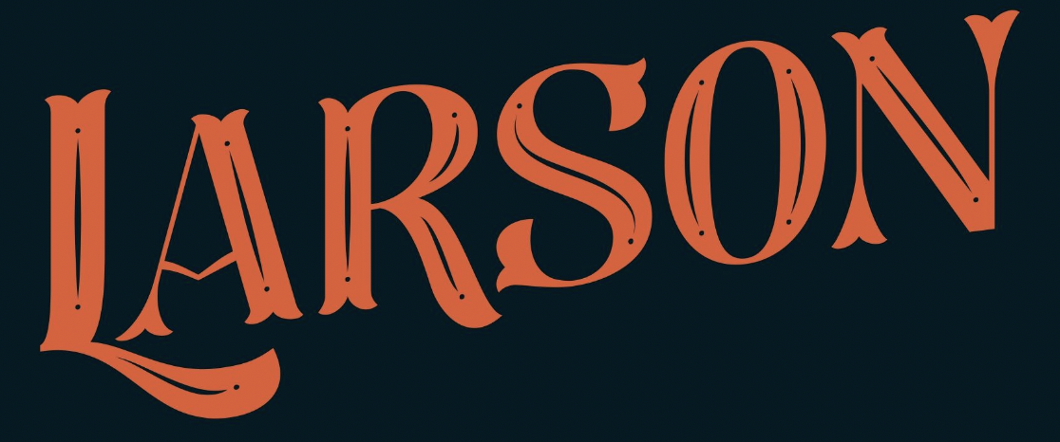
Decorative/Display
Also referred to as display type, decorative fonts are typically used for titles and headlines or for small amounts of text in large sizes such as in greeting cards or posters.

Slide 9

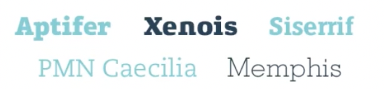
Slab Serif
In typography, a slab serif typeface is a type of serif typeface characterized by thick, block-like serifs. Serif terminals may be either blunt and angular or rounded.

Slide 10
02
Fonts & Emotions

Slide 11
Serif
90%
Official Statement
Seriousness
Reliability
Authority
Respectability
10%
Class
Tradition
Elegance
Luxury

Slide 12
Sanserif
90%
Emotionless font
Use where people have different perceptions
Neutral
Objective
Stable
10%
Thin, ultra-thin, light, extra light
serif

Slide 13
Script
Softness
Love
Lady
Engagement
Makeup
Beauty product
Notes:
Note: We can use here the combination of serif and script to make a more luxurious look.

Slide 14
Decorative/Display
Hard (like a gym)
speed
Energy
Casual
Chic
Stylish
Progressive
Intelligence

Slide 15
Slab Serif
Neither more serious nor more casual
Bold
Strong
Expressive

Slide 16
03
Fonts Selection

Slide 17
How to Choose Fonts for your Design?
Always use the professional font
Identify the audience then go for the font
Choose from the article’s website
Professional font: The font with all family i.e italic, thin, regular, bold,ultra-thin, extra bold, etc.

Slide 18
04
Fonts Pairing like a pro

Slide 19
Powers of each element
Heading
Sub-heading
Description

Slide 20
05
Typography & brand connection

Slide 21
Types of clients
Known Brands
Start-up Clients
Scratch Brands

Slide 22
Known Brands
They have always their brand brief.
They have fixed fonts.
If you want to change take approval.
Always experiment with design for well-established clients, not with their fonts

Slide 23

Start-up Brands
Fix their typography issues.
Make designs with the same typography

Slide 24

Scratch Brands
Fix their issues regarding don’t
Don’t use logo font in designs
Fix Design fonts

Slide 25
Any Questions?

Slide 26
Thank you!

